Slide 1
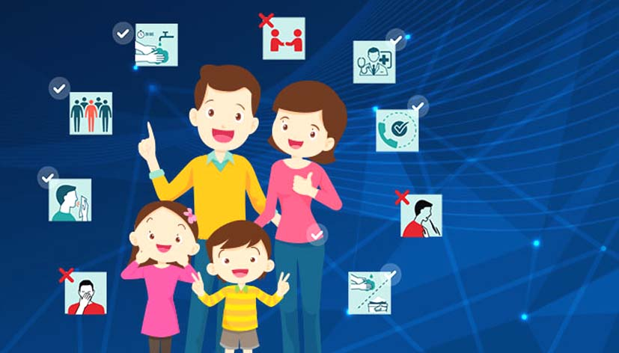
Minding our minds during the COVID-19

Slide 2
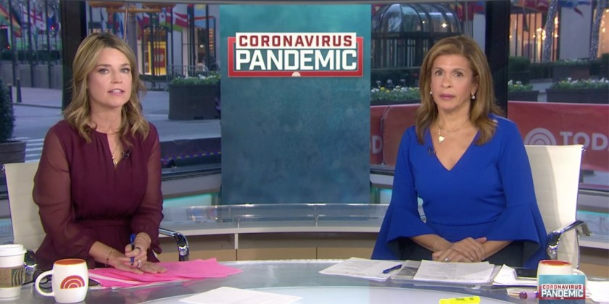
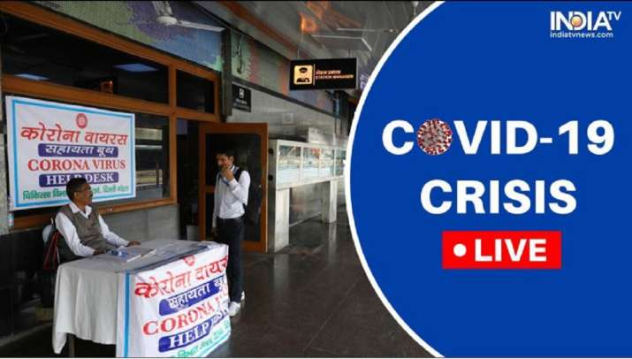
These can be difficult times for all of us as we hear about spread of COVID-19 from all over the world, through television, social media, newspapers, family and friends and other sources.

Slide 3
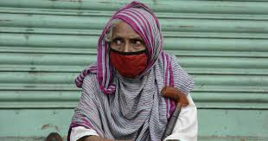
The most common emotion faced by all is Fear.
It makes us anxious, panicky and can even possibly make us think, say or do things that we might not consider appropriate under normal circumstances.

Slide 4
Understanding the importance of Lockdown
Lockdown is meant to prevent the spread of infection from one person to another, to protect ourselves and others.
This means-
not stepping out of the house except for buying necessities,
reducing the number of trips outside,
and ideally only a single, healthy family member making the trips when absolutely necessary.
If there is anyone in the house who is very sick and may need to get medical help, you must be aware of the health facility nearest to you.

Slide 5
Handling Social isolation
Staying at home can be quite nice for some time, but can also be boring and restricting.
Here are some ways to keep positive and cheerful.
Be busy. Have a regular schedule. Help in doing some of the work at home.
Distract yourself from negative emotions by listening to music, reading, watching an entertaining programme on television.
If you had old hobbies like painting, gardening or stitching, go back to them. Rediscover your hobbies.

Slide 6
Handling Social isolation
Eat well and drink plenty of fluids.
Be physically active. Do simple indoor exercises that will keep you fit and feeling fit.
Sharing is caring. Understand if someone around you needs advice, food or other essentials. Be willing to share.

Slide 7
Elderly people may feel confused, lost and need help. Offer them help by getting them what they need, their medicines, daily needs etc.
If you have children at home, keep them busy by allowing them to help in the household chores - make them feel responsible and acquire new skills

Slide 8
Focus on facts, reject rumors and theories
Knowledge is power; the more you know about a certain issue, the less fearful you may feel.
Make sure to access and believe only the most reliable sources of information for self-protection.
Do not follow sensational news or social media posts which may impact your mental state. Do not spread or share any unverified news or information further.
Do not keep discussing all the time about who got sick and how. Instead learn about who got well and recovered.

Slide 9
Focus on facts, reject rumors and theories
Stick to the known advice- hand hygiene and keeping a physical distance from others.
It is being careful about yourself, and also about care of others.
A common cold is not Corona infection. The symptoms of Corona have been well described.

Slide 10
Follow etiquette of sneezing, coughing, avoiding spitting in public places etc.
In most people, the Corona infection causes mild symptoms and the person only needs to follow social distancing till he/she stops being infective, usually 2 weeks.
Mild infection does not require a person to be admitted in hospital. Only people who have breathing difficulties need to be in hospital. Most people recover.

Slide 11
Handling emotional problems
At times of anxiety, practice breathing slowly for a few minutes. Try and distance the thoughts that are making you anxious. Think of something calm and serene, and slow down your mind.
When feeling angry and irritated, calming your mind, counting back from 10 to 1, distracting yourself helps.
Even when feeling afraid, deal with it by asking yourself:
a. What is under my control?
b. Am I unnecessarily worrying about the worst thing that can happen?
c. When I have been stressed in the past, how have I managed?
d. What are the things I can do to elp hmyself and be positive?

Slide 12
Handling emotional problems
Feeling lonely or sad is also quite common. Stay connected with others.
Communication can help you to connect with family and friends. Call up people whom you haven’t spoken to and surprise them.
Discuss happy events, common interests, exchange cooking tips, share music.

Slide 13
Handling emotional problems
If any of these emotions persist continuously for several days, despite your trying to get out of it, talk about it with someone.
If the feelings worsen, a person may feel helpless, hopeless and feel that life is not worth living. If that happens, call at helpline number (080-46110007) for advice from a mental health professional or contact your doctor / mental health professional.

Slide 14
What is NOT advisable
Avoid tobacco, alcohol and other drugs. Use of tobacco or alcohol or other drugs to cope with emotions or boredom can worsen physical, mental health and reduce immunity.
People who already have a substance use problem may require professional help, especially when they feel low in mood or stressed.
Do not shun or judge people with a CoVid infection. While you need to maintain a physical distance and keep yourself safe to prevent such infection, remember they need care and concern.

Slide 15
What is NOT advisable
If you know someone who might have the infection, tell them about precautions, and how to get medical assistance, if required.
If you happen to get infected with Corona, remember most people get better. Do not panic. Practice self-isolation and take medications that are advised.

Slide 16
Emotional issues after recovery
While it is wonderful to recover from Covid infection, you may actually face stress after you have recovered and wish to get back into the community. You may have fear about your loved ones falling ill.
People who do not understand the illness well may actually keep you at a distance, which is also very stressful and isolating.

Slide 17
Emotional issues after recovery
You may experience feelings of guilt that you were not able to work or care for others. This may lead to feelings of depression, helplessness or frustration.
Use the ways mentioned earlier to deal with these feelings. Share your positive story that it is possible to recover from COVID infection.

Slide 18
Recognize mental health problems in your near and dear ones
Just as you can recognize your own mental health problems, be sensitive to such problems in your near and dear ones, which may include:
Changes in sleep patterns
Difficulty in sleeping and concentrating
Worsening of health problems
Increased use of alcohol, tobacco or drugs
Be supportive to them. If the problems persist, please contact the helpline (080-46110007) or contact your doctor or a mental health professional.

Slide 19
Persons with mental illness
Persons who had previous mental illness may face newer challenges during self-isolation or Covid infection:
They would also have the same fears and stress as others which may worsen their previous mental health condition
Social isolation may make them more withdrawn, moody and irritable
They may not seek/ get easy access to medicines and counselling

Slide 20
Contd…
Help and support is vital for persons with mental illness from their families and other care givers.
Health helplines can provide support, in addition to regular taking of prescribed medication, a regular daily routine, keeping engaged and positive.
Remember, good mental status in the difficult times may win you the battle more easily!

Slide 21
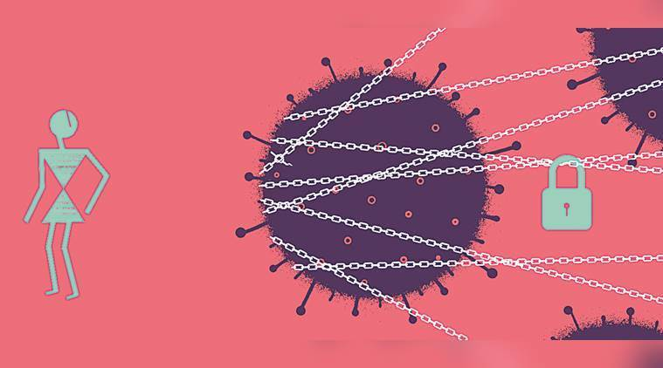
Thank you
Stay Safe

